Slide 1
Not All Bugs Are the Same: Understanding, Characterizing, and Classifying the Root Cause of Bugs Published in : Journal of Systems and Software (2019)
Gemma Catolino, Fabio Palomba, Andy Zaidman, Filomena Ferrucci
COSC 590B 001 – Graduate Seminar
Pragya Bhandari, Department of Computer Science, Mathematics, Physics and Statistics

Slide 2
Contents
Introduction
Motivation
Goals
Dataset
Research Question 1
Research Question 2
Research Question 3
Experiments
Critiques
Conclusion
Notes:
In this presentation, we will go through the following segments to demonstrate my understanding and analysis of the paper.

Slide 3
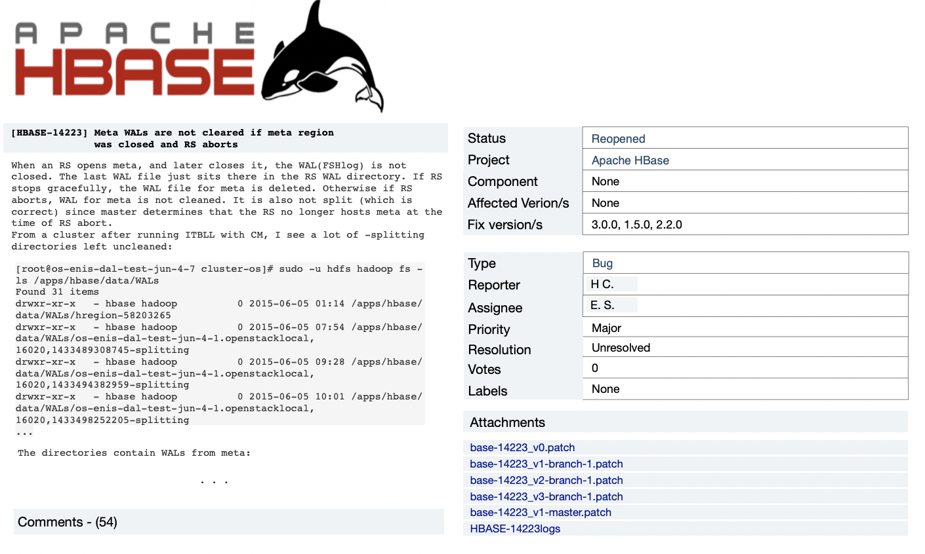
Introduction
Figure 1: Bug reported and reopened in Apache HBase. [1]
[1] G. Catolino, F. Palomba, A. Zaidman, and F. Ferrucci, “Not all bugs are the same: Understanding, characterizing, and classifying the root cause of bugs,” 2019.
Notes:
Let me first introduce the concepts that are related to the paper to give a sense of the background of the problem and the research at hand.
The central entity we will be discussing today are software bugs. Software bugs are one of the highly analyzed entities in the software development field.
In order to manage them throughout the software development life cycle, they are tracked using bug-tracking systems. When a bug is detected, a bug report is opened and various information related to the bug is added to this report. You can see an example of a bug report in this slide.
Then the team would have a meeting to discuss which open bugs to prioritize based on their severity/priority.
After the prioritization of bugs, a lead would assign the bugs to the most appropriate developer. This decision might be based upon the availability of resources as well as which developer had the most experience in the area where the bug was caused.
However, it cannot always be known what might be the root cause of a bug through the bug report. This leads us to the motivation of the paper by Catolino et al.

Slide 4
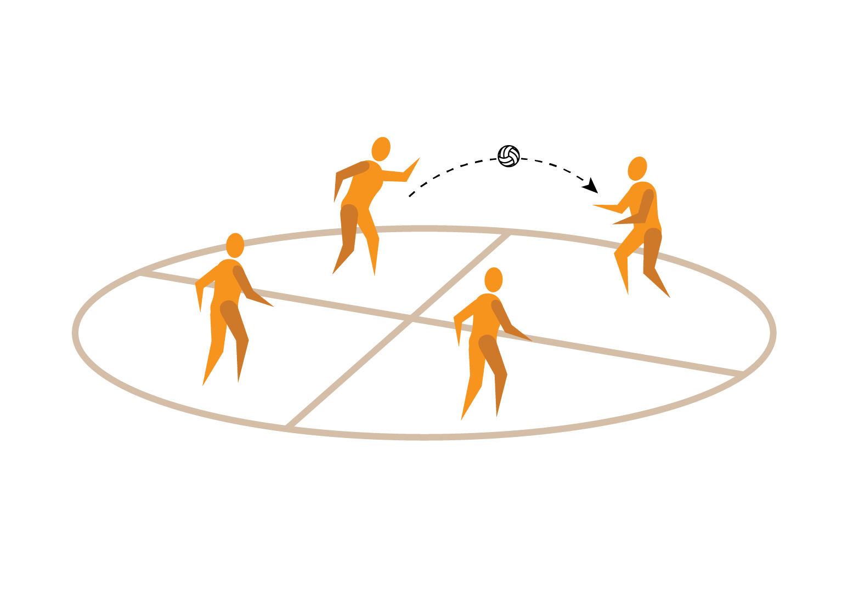


Motivation
Efficient debugging
Reduce bug tossing
Notes:
The paper wanted to understand types of bugs based on their root causes. What motivated them?
First is Efficient Debugging: This is quite straightforward, once u have a vague idea of the cause of the bug, the debugging process will become easier and localized.
Second is To reduce the problem of bug tossing: The phenomenon of bug tossing is when you assign a bug to a dev, but either they cannot fix it and the bug has to be re-assigned to someone else, or the bug was reopened later and needs to be re-assigned to someone else who is available at this time. The paper believed that if the root cause of a bug was known right when a bug was opened, the bug tossing problem would not occur as the bug assigning process would be aided by the information.

Slide 5


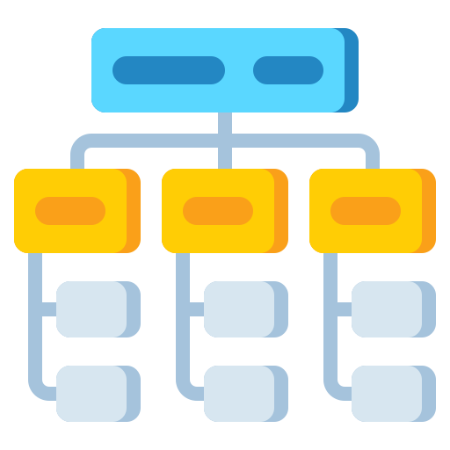
Goals
Build a Taxonomy of bug types based on root causes
Analyze each bug category
Bug Classification model building

Slide 6
Dataset
Ecosystem | Project | Bug Reports
Apache | 60 | 406
Eclipse | 39 | 444
Mozilla | 20 | 430
Overall | 119 | 1280
Table 1: Characteristics of Ecosystems in the Dataset
Notes:
1280 bug reports from three software ecosystems, with 119 different projects
The systems Mozilla, Apache and Eclipse were chosen because their bugs were complete and understandable.
The bug reports considered were ‘fixed’ or ‘closed’

Slide 7

RQ1: To what extent can bug root causes be categorized through the information contained in bug reports?
First draft taxonomy
Categorize 100 Bugs
Iteration 1:
Categorize another 200 Bugs
Second refined draft
Iteration 2:
Re-categorize 300 Bugs
Final draft of taxonomy
Iteration 3:
Notes:
Iteration 1: analyzed an initial set of 100 bug reports. Then, they opened a discussion on the labels assigned to the root causes identified so far and tried to reach consensus on the names and meaning of the assigned categories.
Iteration 2: The inspectors firstly re-categorized the 100 initial bug reports according to the decisions taken during the discussion, then used the draft taxonomy as basis for categorizing another set of 200.
Iteration 3: The inspectors re-categorized the 300 bug reports previously analyzed. Afterward, they completed the final draft of the taxonomy verifying that each kind of bug root cause encountered in the final 339 bug reports was covered by the taxonomy.

Slide 8
Results for RQ1: 9 Root Causes
Configuration Issue
Network Issue
Database-related Issue
GUI-Related Issue
Performance Issue
Permission/Deprecation Issue
Security Issue
Program Anomaly Issue
Test Code related Issue

Slide 9


RQ2: What are the characteristics, in terms of frequency, and topics, of different bug categories?
Frequency Analysis
Topic Analysis

Slide 10
Frequency Analysis
Issue type | Frequency
Program Anomaly Issue | 41%
GUI-related Issue | 17%
Configuration Issue | 16%
Test Code related Issue | 7%
Performance Issue | 4%
Permission/Deprecation Issue | 4%
Security Issue | 4%
Network Issue | 4%
Database Related Issue | 3%
Table 2: Frequency Analysis
Notes:
In the results of the Frequency Analysis, we see that almost half of the issues were Program Anomaly issue which are issues caused by code enhancements or while implementing new features.
The second most frequent issue type is the GUI-related issue, which comprises mostly front end and design related issues.
Configuration issue : involves issues caused due to external libraries or APIs.

Slide 11
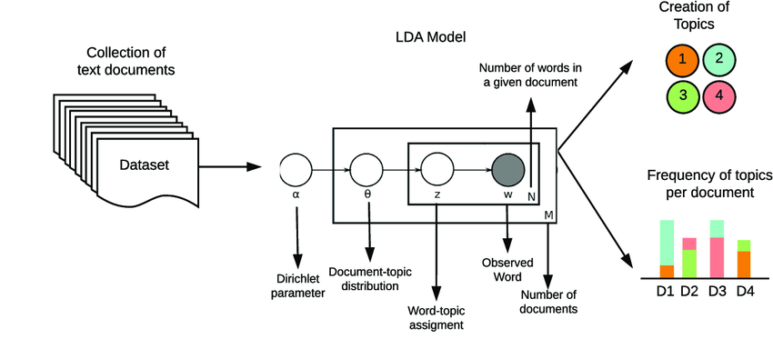
Topic Analysis
Isolate topic words for each category
Approach: LDA – GA (Latent Dirichlet Allocation – Genetic Algorithm)
Figure 1: Schematic of LDA Algorithm [2]
[2] D. Buenáno-Fernandez, M. González, D. Gil, and S. Luján-Mora, “Text mining of open-ended questions in self-assessment of university teachers: An lda topic modeling approach,” IEEE Access, vol. 8, pp. 35 318–35 330, 2020.
Notes:
The paper used LDA-GA, which is Latent Dirichlet Allocation – Genetic Algorithm. It is a variation of LDA, wherein the GA automatically finds the most optimal parameter of the model instead of us having to input one. LDA is a topic modelling method which takes in a collection of text documents, and gives out two things: One is different groups of words clustered into topics. For example: Topic 0: injury, score, win, field, court etc., and Topic 1: profit, economy, stocks, trade etc. The second output that the model can give us is a frequency of topics per document, which enables it to tell us which document would most likely belong to which topic.
The main intuition of the model is it assumes topics are a a probability distribution of words, and documents are a probability distribution of topics.

Slide 12
Topic Analysis
Categories | Topic 1 | Topic 2 | Topic 3 | Topic 4 | Topic 5
Program Anomaly Issue | error | file | crash | exception | -
GUI-related Issue | page | view | render | select | font
Configuration Issue | link | file | build | plugin | jdk
Test Code related Issue | fail | test | retry | - | -
Performance Issue | thread | infinite | loop | memory | -
Permission/Deprecation Issue | deprecated | plugin | goal | - | -
Security Issue | security | xml | packageaccess | vulnerable | -
Network Issue | server | connection | slow | exchange | -
Database Related Issue | database | sql | connection | connection | -
Table 3: Topic Distribution across the Bug Categories using LDA-GA [3]
[3] Catolino, G., Palomba, F., Zaidman, A., & Ferrucci, F. (2019). Not All Bugs Are the Same: Understanding, Characterizing, and Classifying the Root Cause of Bugs.

Slide 13
RQ3: How effective is their classification model in classifying bugs according to their root cause
Hyperparameter tuning using Grid Search Algorithm
Dataset
Classifiers
Naïve Bayes
Support Vector Machine
Logistic Regression
Random Forest
Independent var: Bug Summary
Text Pre-processing
Dependent var: Bug Category
TF-IDF
Word2vec
Doc2vec
Notes:
They start with a dataset containing the Bug’s Summary and the classification of bug type.
They first pre-process all textual data from the bug summary and then feed the processed text through three feature extraction methods i.e., TF-IDF, Word2Vec and Doc2Vec
Then they perform hyperparameter tuning using Grid Search algorithm to optimize this process.
And they performed experiments on these models, Naïve Bayes, Support Vector Machine, Logistic Regression and Random Forest.

Slide 14
RQ3: Results
Best Feature Extractor: TF-IDF
Issue type | Logistic Regression
 | PRECISION | RECALL | F-MEASURE
Configuration issue | 46.5 | 51.7 | 49
Network issue | 36.4 | 40.0 | 38
Database-related issue | 71.0 | 63.4 | 67
GUI related issue | 61.5 | 68.0 | 65
Performance issue | 67.3 | 57.5 | 62
Permission/Deprecation issue | 85.9 | 55.0 | 67
Security issue | 76.4 | 73.6 | 75
Functional issue | 67.9 | 65.2 | 67
Test-related issue | 90.4 | 69.9 | 79
OVERALL | 67.0 | 60.5 | 64
Table 3: Logistic Regression and TF-IDF Performance for Bug Classification Model

Slide 15
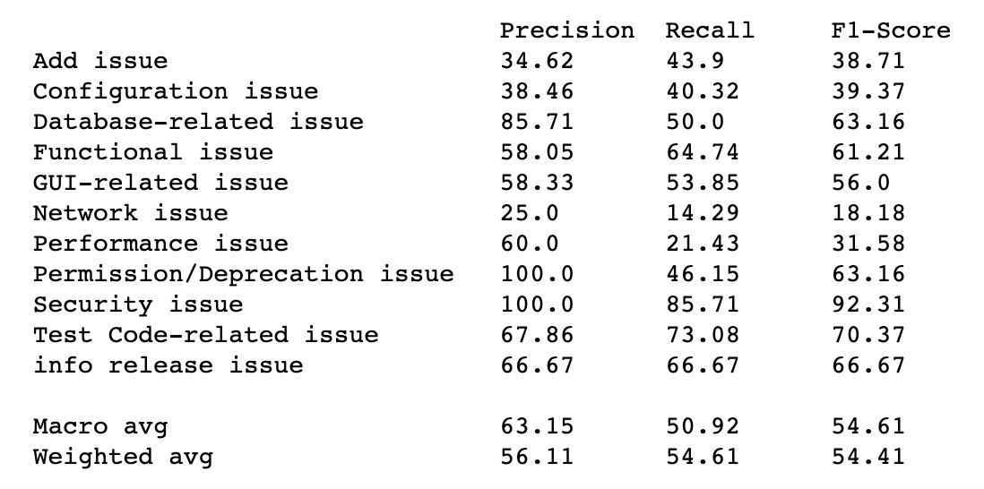
Replication Attempt
Figure 2: Screenshot of the Results from Logistic Regression model with the given replication package.

Slide 16

Experiments
BERTopic
Comparative study by Egger and Yu [4] showed BERTopic performs better than LDA.
[4] R. Dr. Egger and J. Yu, “A topic modeling comparison between lda, nmf, top2vec, and bertopic to demystify twitter posts,” Frontiers in Sociology, vol. 7, 05 2022.
Notes:
BERTopic is a topic modelling technique that is fairly newer with its first release in 2020.

Slide 17
Experimental Results
Categories | Topic 1 | Topic 2 | Topic 3 | Topic 4 | Topic 5
Program Anomaly Issue | patch | file | crash | exception | agent
GUI-related Issue | html | link | render | table | panel
Configuration Issue | link | server | build | plugin | review
Test Code related Issue | failure | test | junit | regression | ignore
Performance Issue | thread | infinite | loop | memory | leak
Permission/Deprecation Issue | deprecated | removal | hibernation | transfer | adapt
Security Issue | security | cocoon | packageaccess | server | file
Network Issue | server | build | redirect | abort | connection
Database Related Issue | database | queries | select | search | patch
Table 4: Topic Distribution across the Bug Categories using BERTopic with K-means Cluster model

Slide 18
Critiques
Lack of methodological decisions
(2) Incomplete replication package

Slide 19

Conclusion
Bug Classification into 9 types based on root causes
Topic Modeling for feature extraction
Not All Bugs are the Same
Insight into bug classification approaches

Slide 20
Notes:
To end the presentation I would like to thank and acknowledge my Research supervisor Dr. Gema Rodriguez Perez for her guidance and support. Thank you.

